Slide 1

Components of Apache Spark

Slide 2
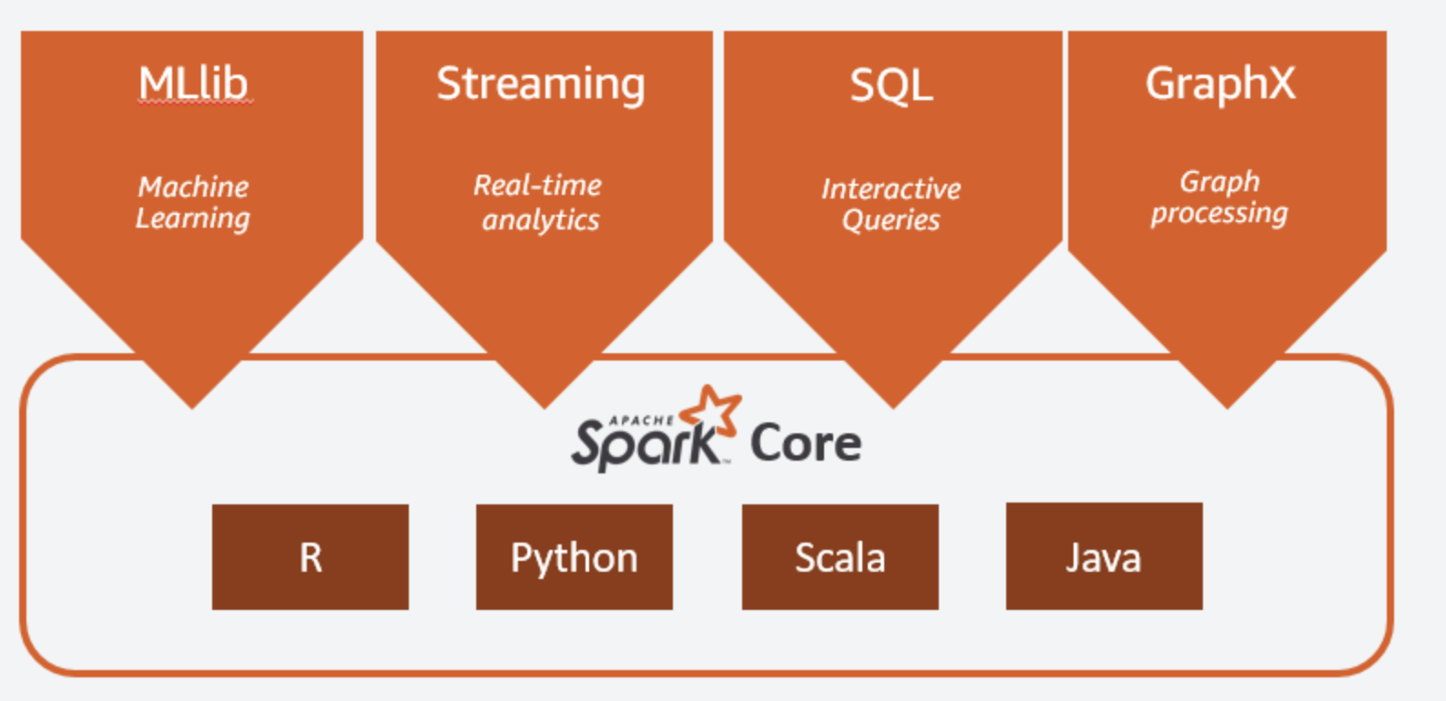
Components of Apache Spark
Spark Core
Spark SQL
Spark Streaming
MLlib
GraphX
Image: aws.amazon.com/big-data/what-is-spark

Slide 3
Spark Core
Spark Core is a critical component of PySPark by providing the foundation
Execution engine of Spark
Provides basic functionality for distributed data processing
Responsible for managing Spark cluster using master-worker architecture
Image: aws.amazon.com/big-data/what-is-spark

Slide 4
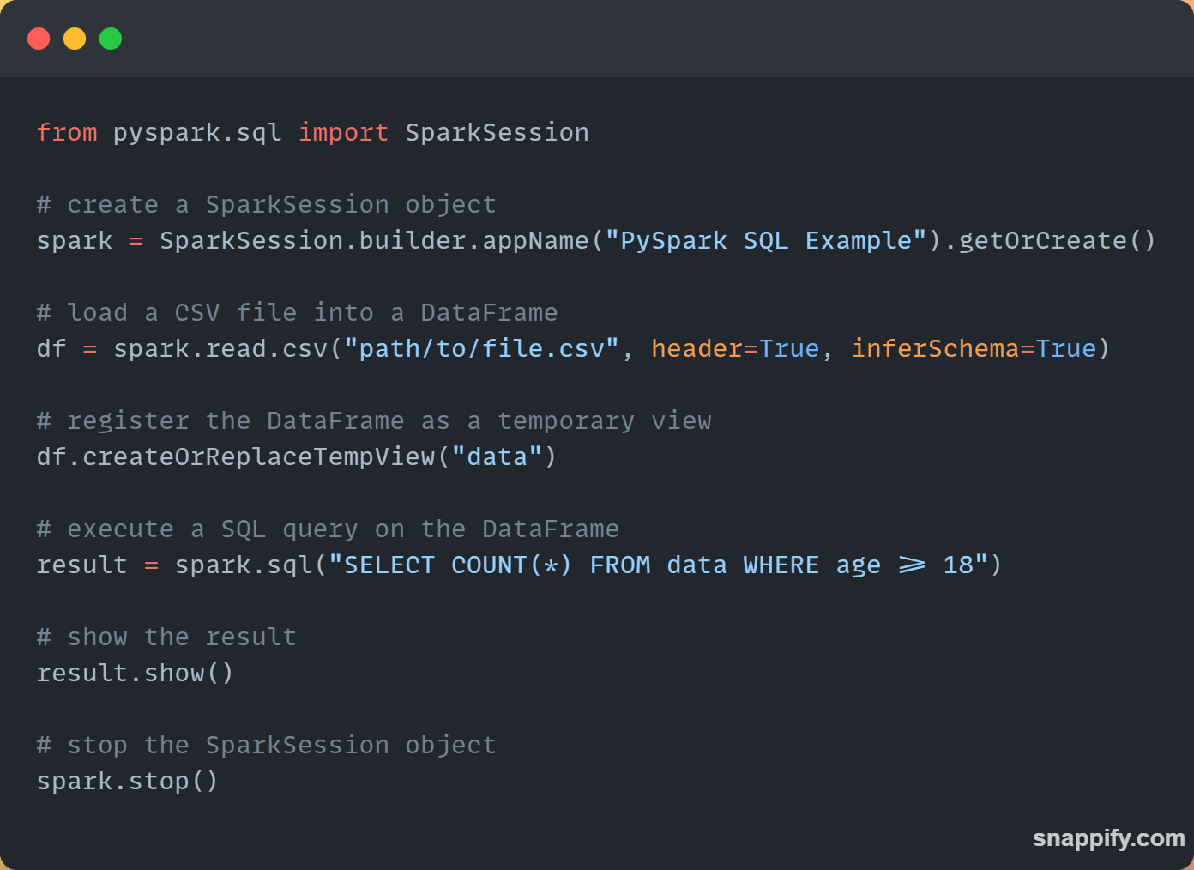
Spark SQL
Programming interface to work structured and semi-structured data
Allows for SQL queries / join data sets and various other operations

Slide 5
Spark SQL
Includes SQL API allowing for queries on data from various data sources
Allows Dataframe API:
Distributed collections of data organized, similar to tables with optimizations

Slide 6
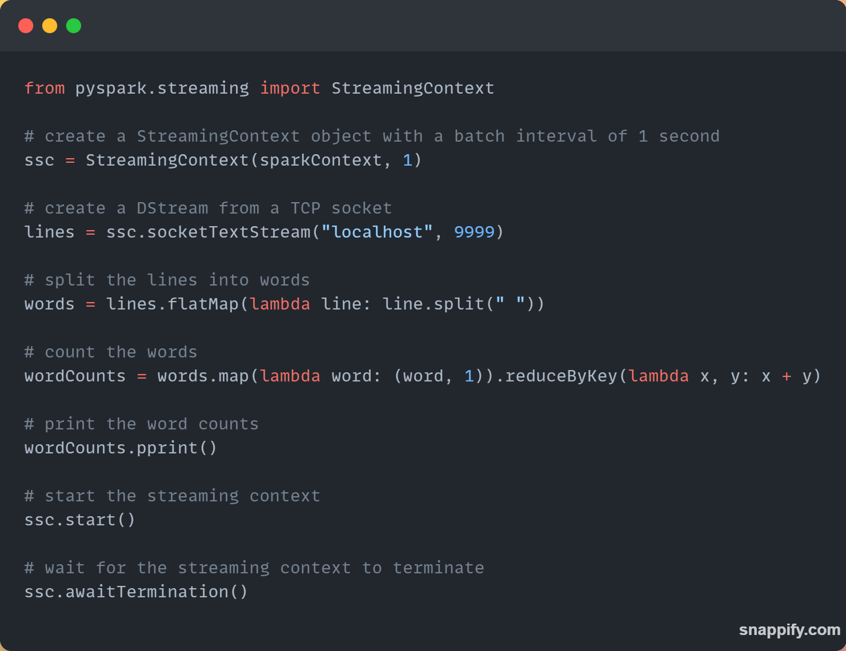
Spark Streaming
A Spark module allowing for live data streams real-time
Provides high-level APIs for processing and analyzing
Allows for ingestion of various sources like Kafka / Kafka / HDFS

Slide 7
Spark Streaming
Using DStream to represent steam data
Allows for large data processing real-time by chunking data and processing in parallel

Slide 8
Next…

